Slide 1
Excel to R
An introduction

Slide 2

Data analysis workflow
Visualise
Import
Tidy
Transform
Communicate
Model

Slide 3
Why reproducible research?
To demonstrate correctness / audit
To allow others to follow methods
To remember what happened…
Students graduate
Future you!

Slide 4
“An article about computational science in a scientific publication is not the scholarship itself it is merely advertising of the scholarship”
–From Claerbout and Karrenbach (1992)

Slide 5
Why it’s hard in Excel

Slide 6
Example - experiment
Treatment A
Treatment B
Glucose measured weekly (3 times) for 4 weeks

Slide 7
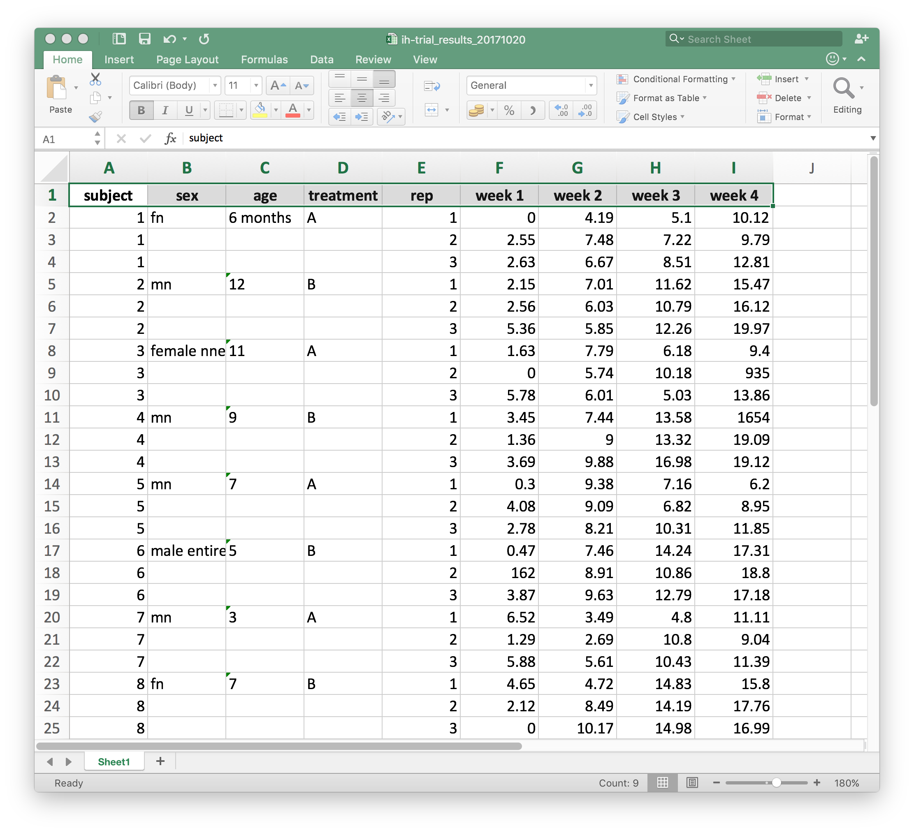

Slide 8
What is R?
Programming language / system for data science
Open source and free
Extended by > 10,000 packages…

Slide 9
“This huge variety of packages is one of the reasons that R is so successful: the chances are that someone has already solved a problem that you're working on, and you can benefit from their work by downloading their package.”
–Hadley Wickham, Chief Scientist RStudio

Slide 10
Visualise
Import
Tidy
Transform
Communicate
Model

Slide 11
The Tidyverse
Import
Tidy
Manipulate/Transform
Visualise
Model
Report

Slide 13
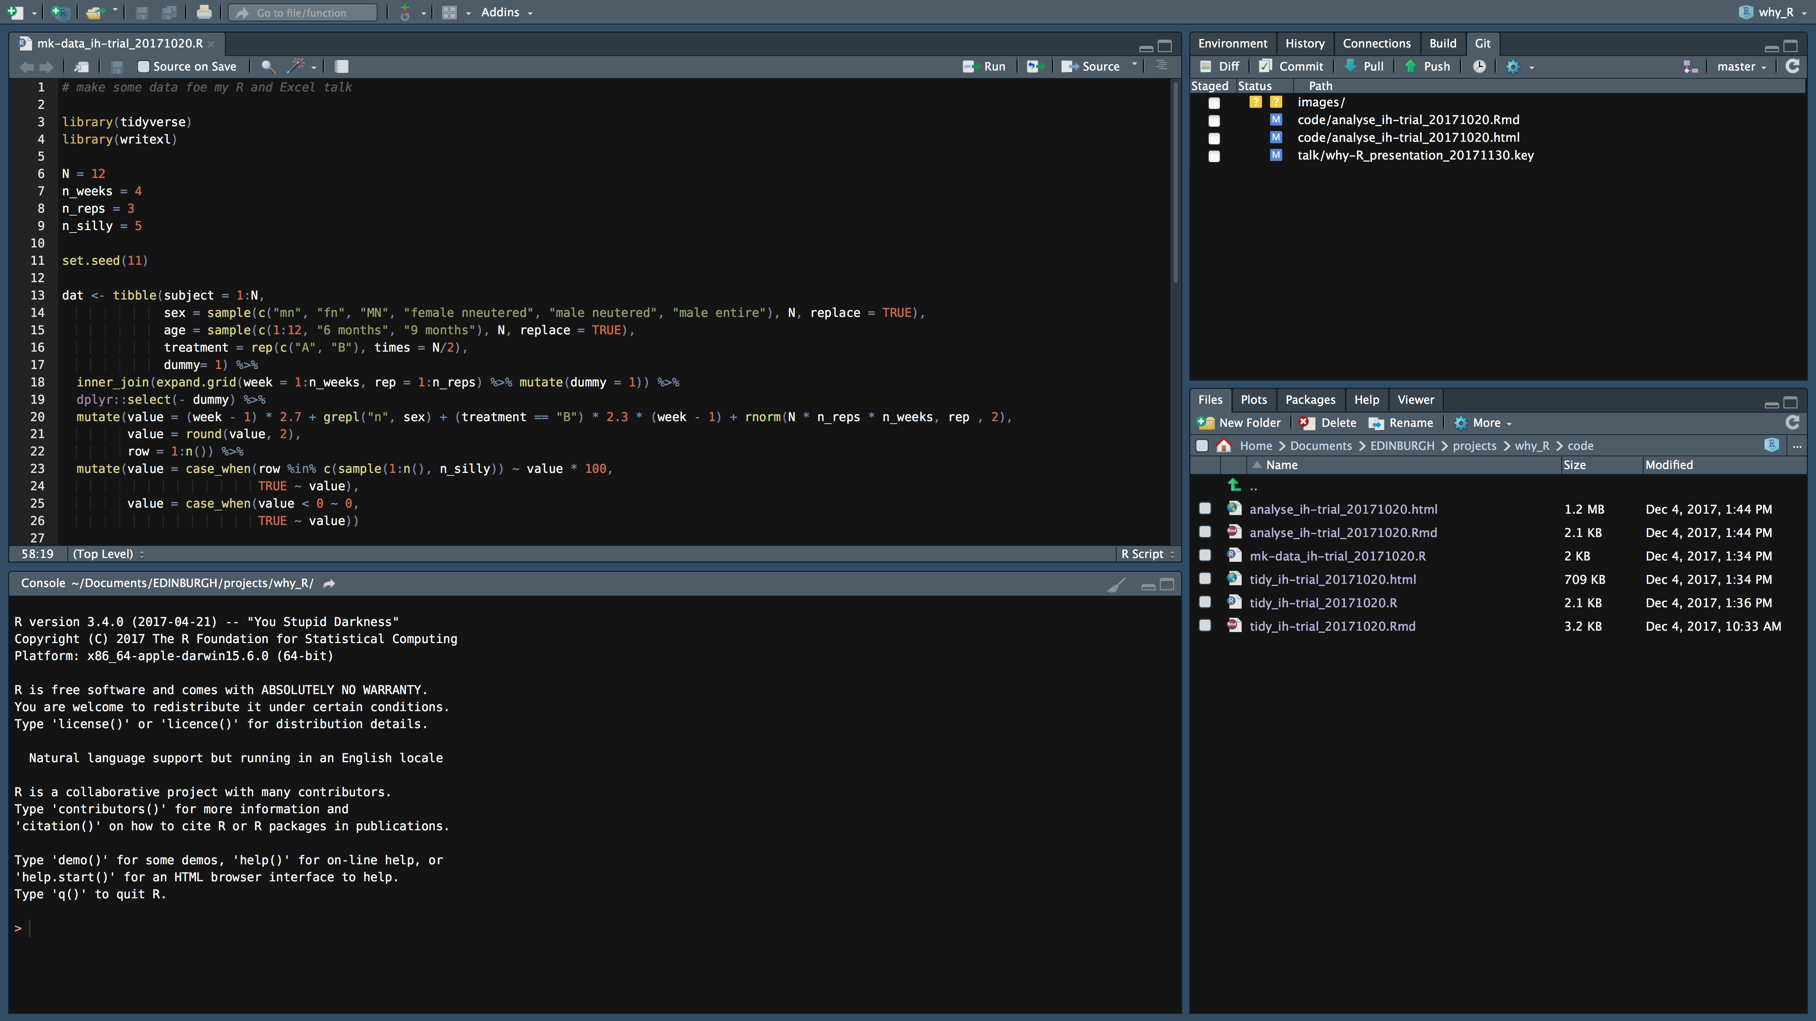
R and RStudio

Slide 14
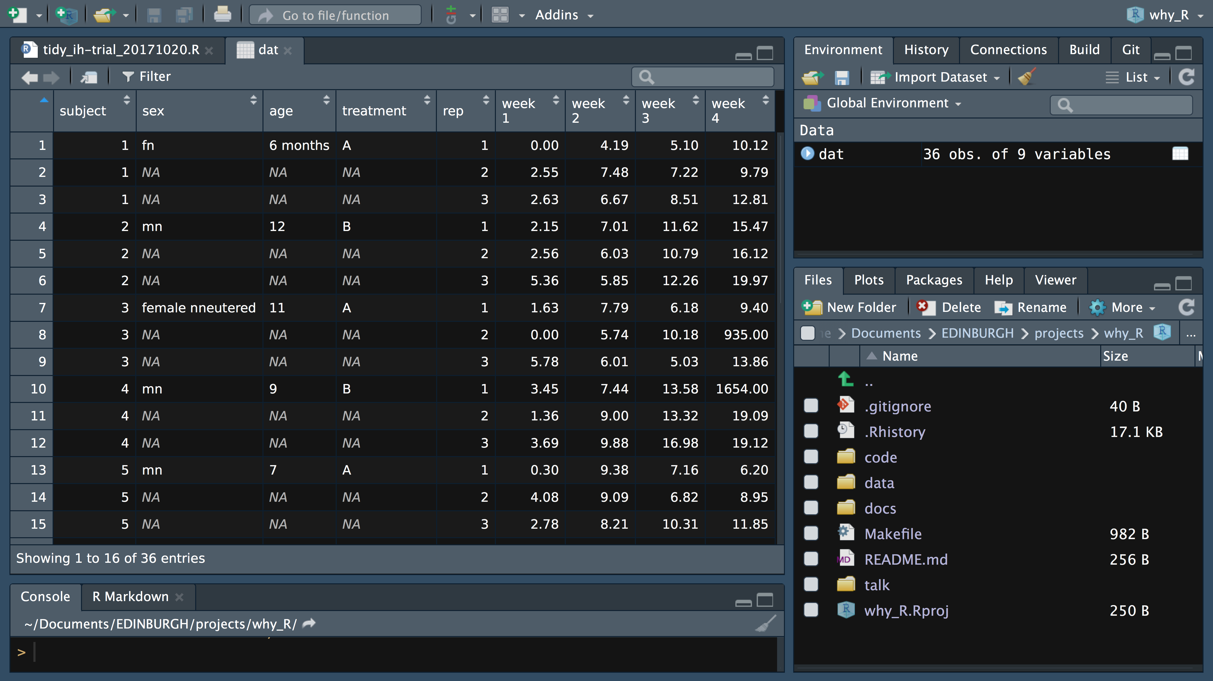
Import the data
dat <- read_excel("../data/ih-trial_results_20171020.xlsx",
sheet = 1)

Slide 15
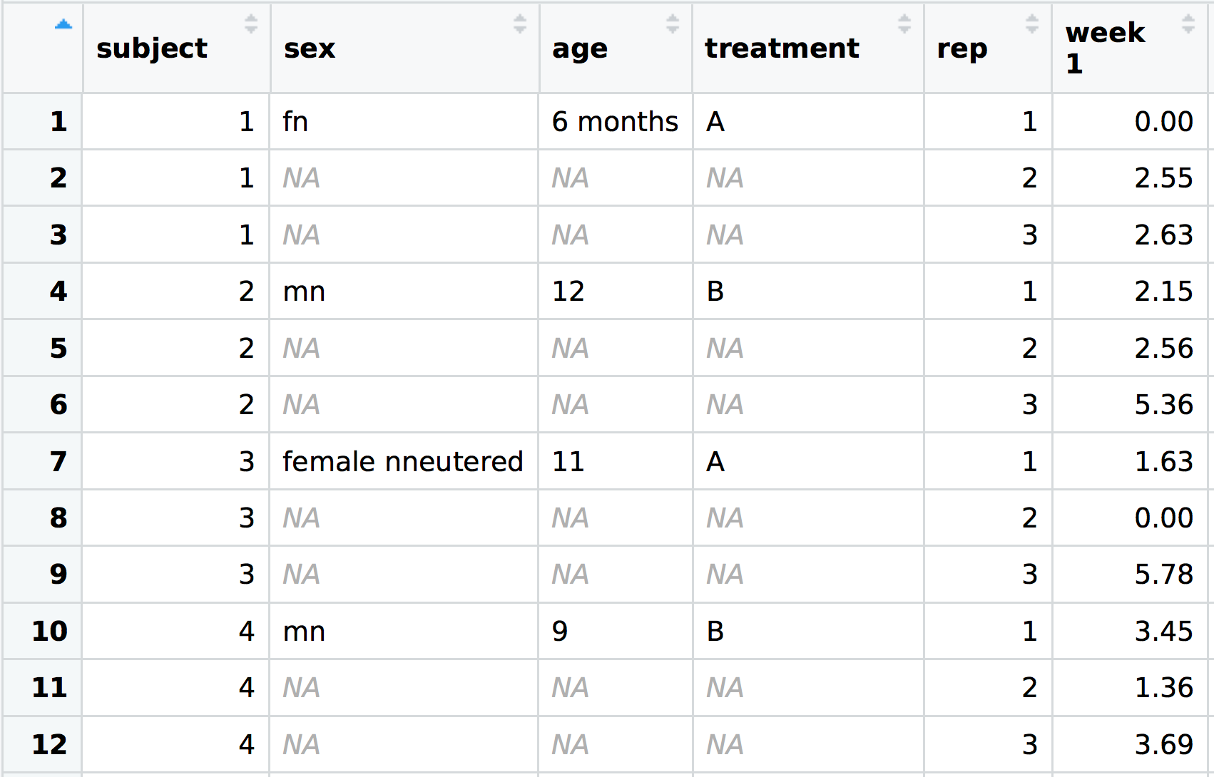
Fill down missing data
dat <- dat %>%
fill(sex, age, treatment)

Slide 16
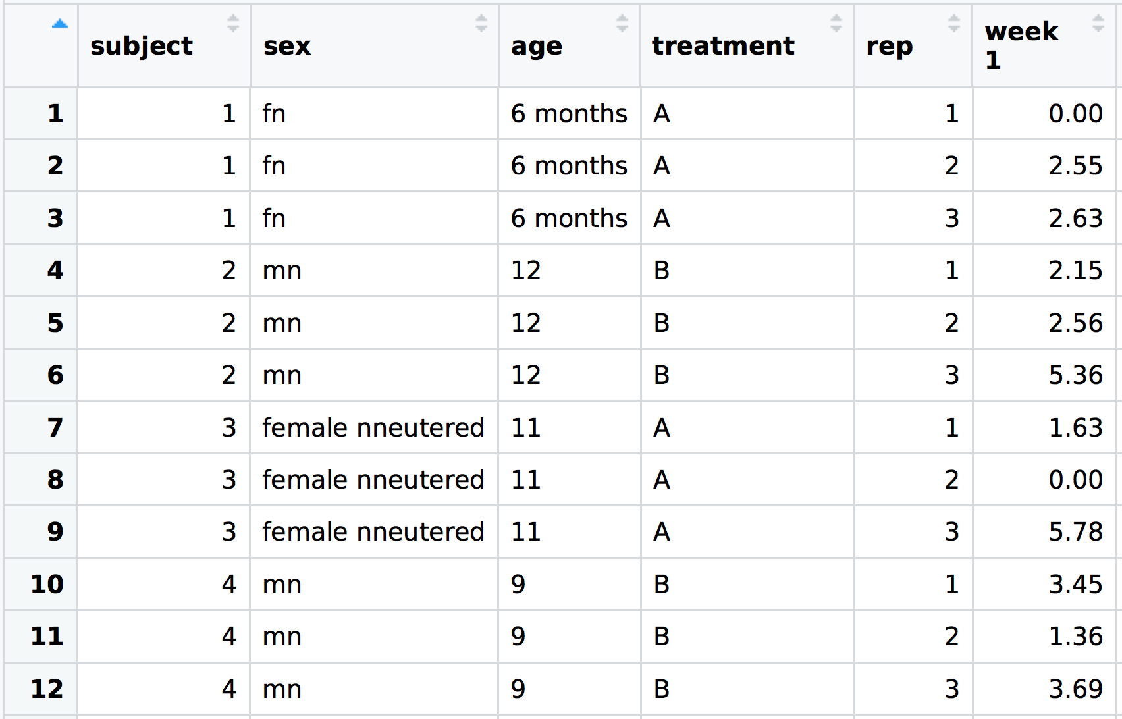
Fill down missing data
dat <- dat %>%
fill(sex, age, treatment)

Slide 17

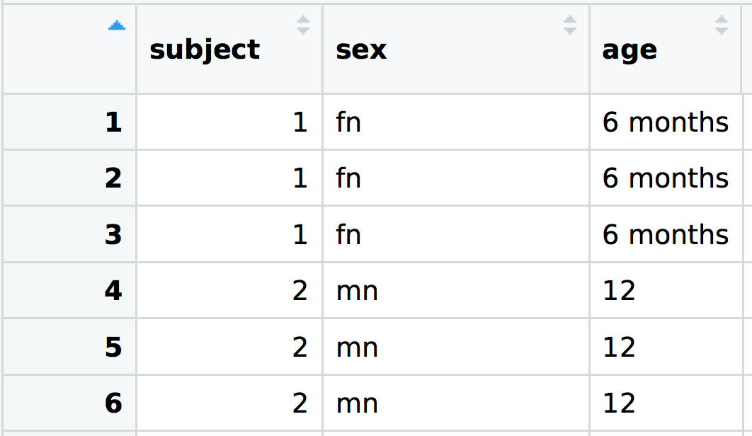
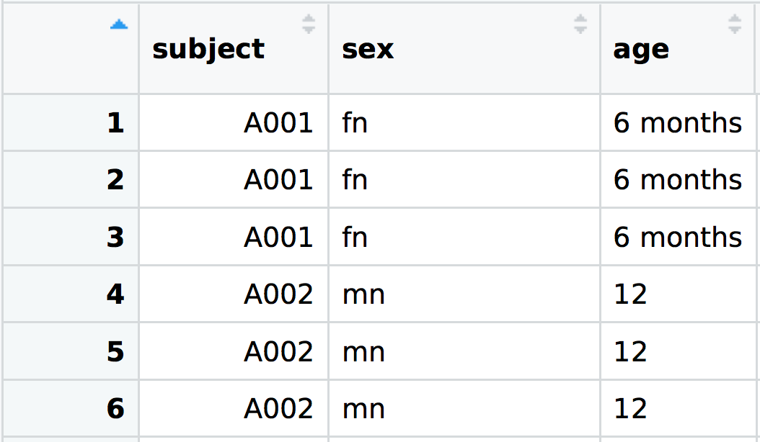
Create a sensible subject ID
dat <- dat %>%
mutate(subject = str_c("A", str_pad(subject, 3, "left", "0")))

Slide 18
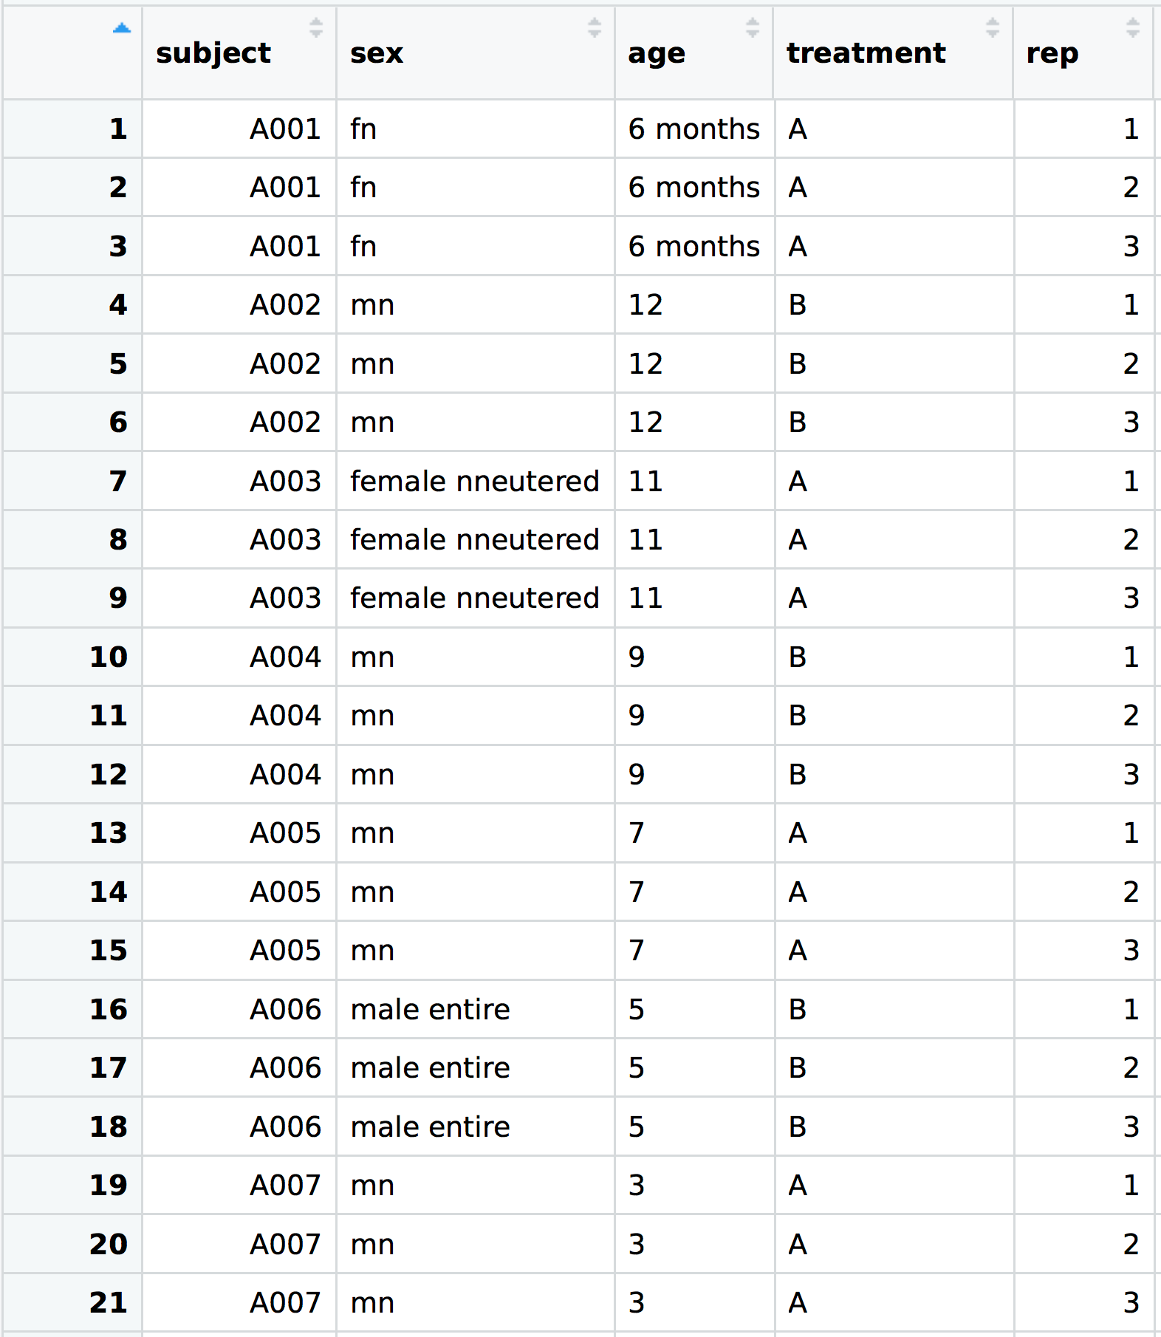



Examine the sex/status column
dat %>%
group_by(sex) %>%
tally()
sex | n
female nneutered | 3
fn | 9
male entire | 6
mn | 15
MN | 3
etc…

Slide 19
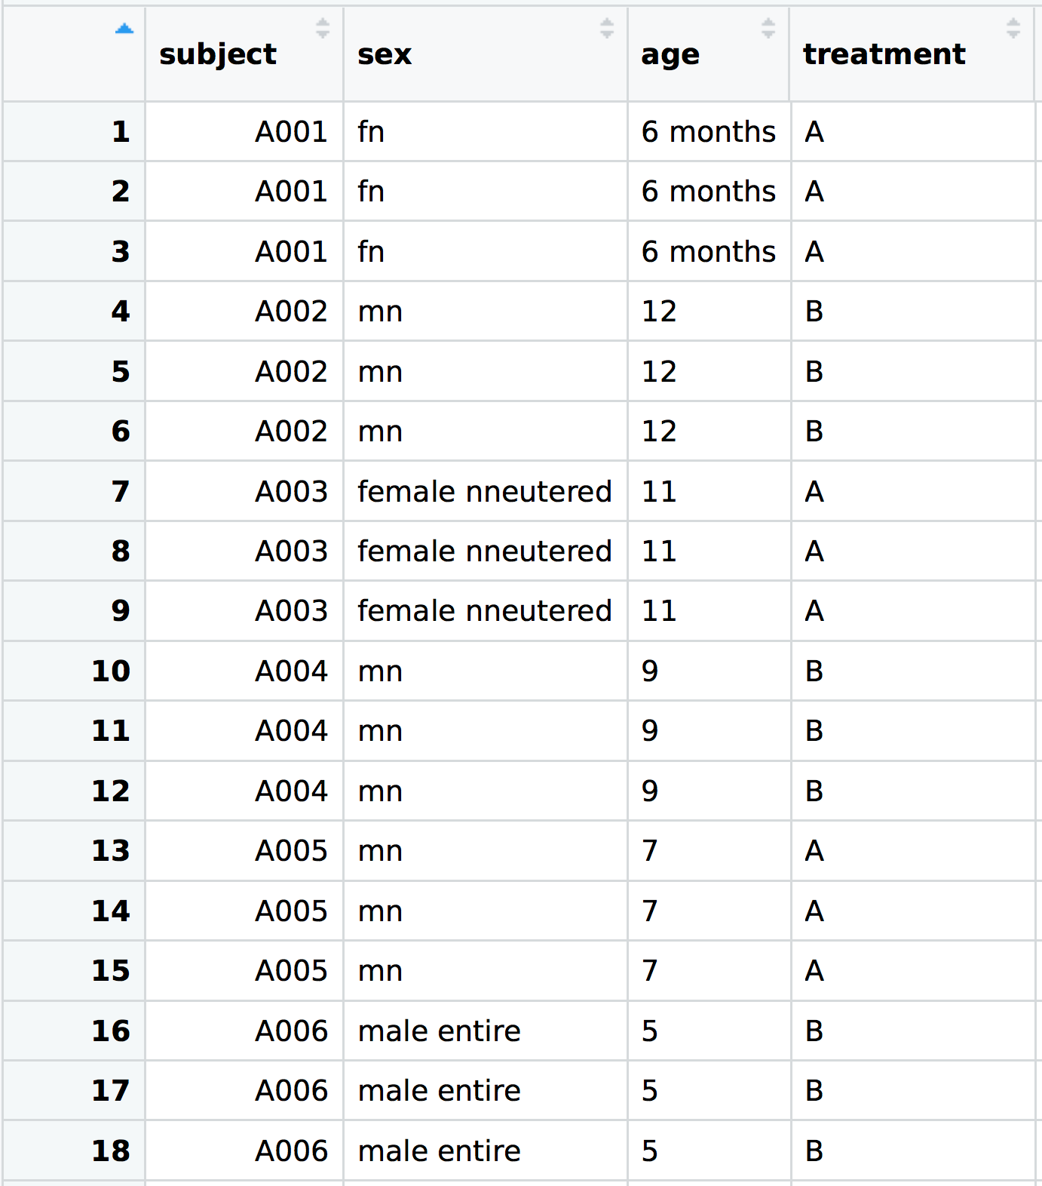
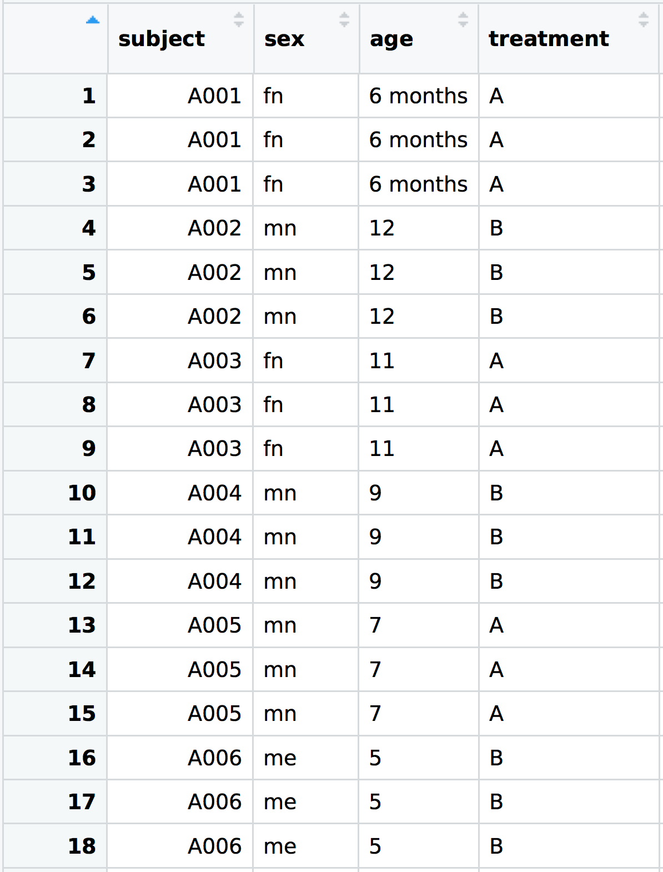
Correct sex/status typos (etc)
dat <- dat %>%
mutate(sex = case_when(sex == "female nneutered" ~ "fn",
sex == "male entire" ~ "me",
sex == "MN" ~ "mn",
TRUE ~ sex))

Slide 20


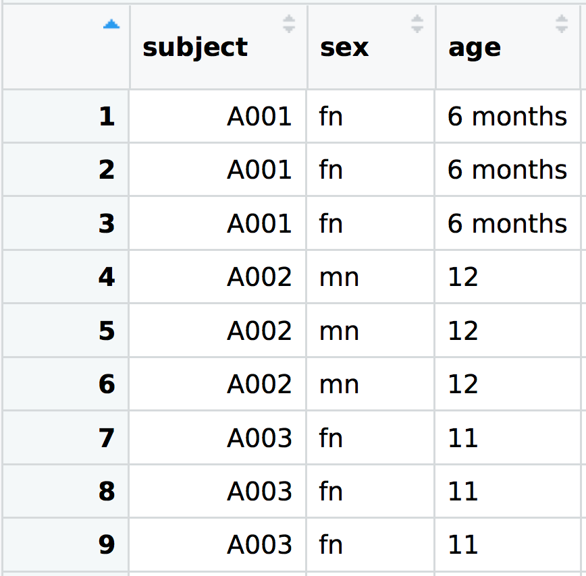
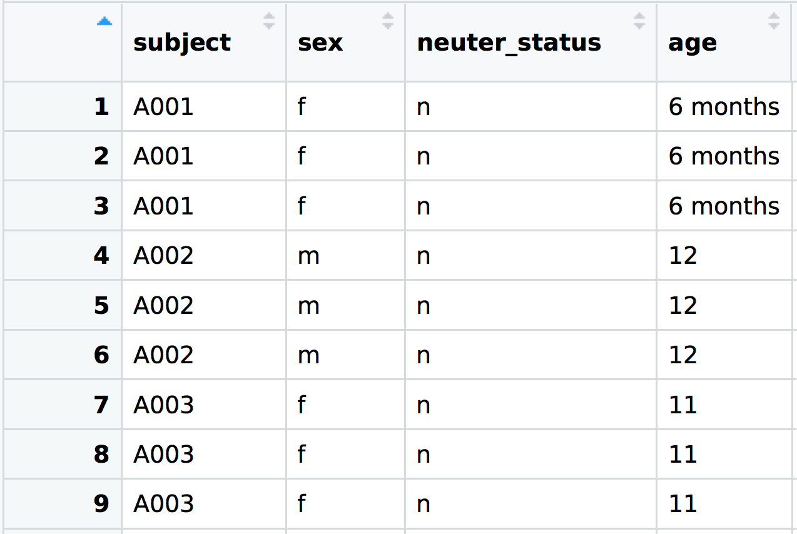
Separate sex/status into two columns
dat <- dat %>%
separate(sex, c("sex", "neuter_status"), sep = 1)

Slide 21


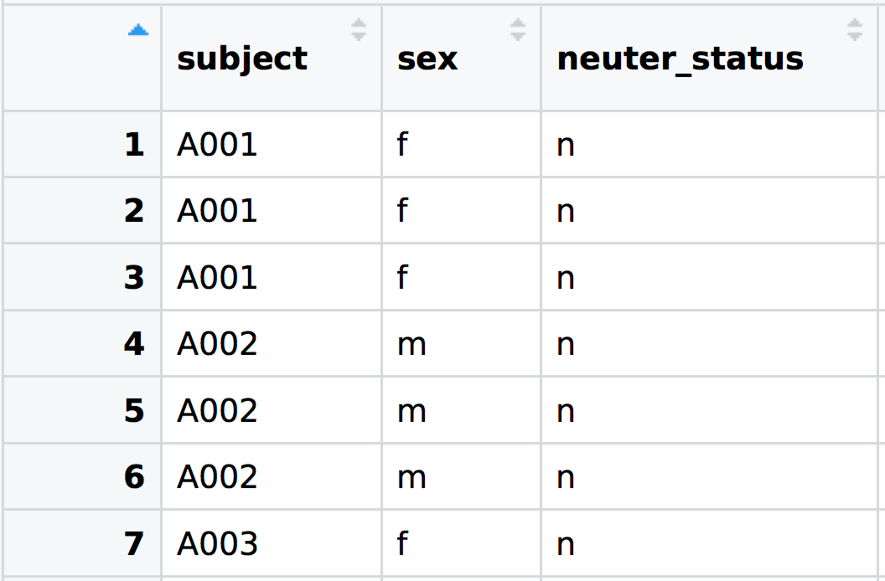
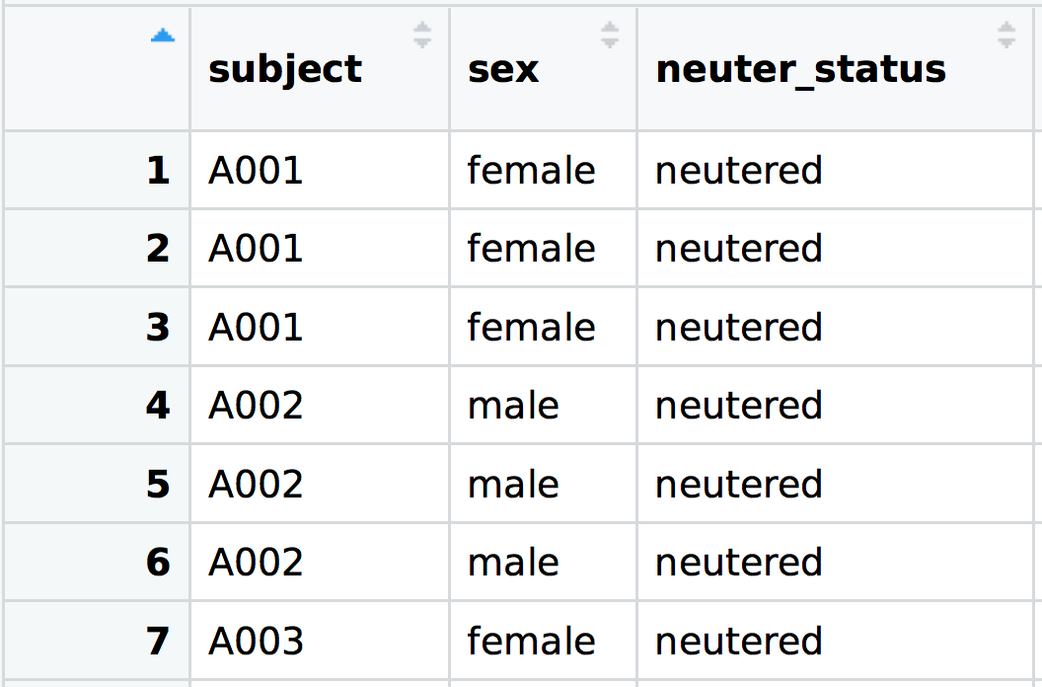
Expand sex and status labels
dat <- dat %>%
mutate(sex = fct_recode(sex,
male = "m",
female = "f"),
neuter_status = fct_recode(neuter_status,
neutered = "n",
entire = "e"))

Slide 22

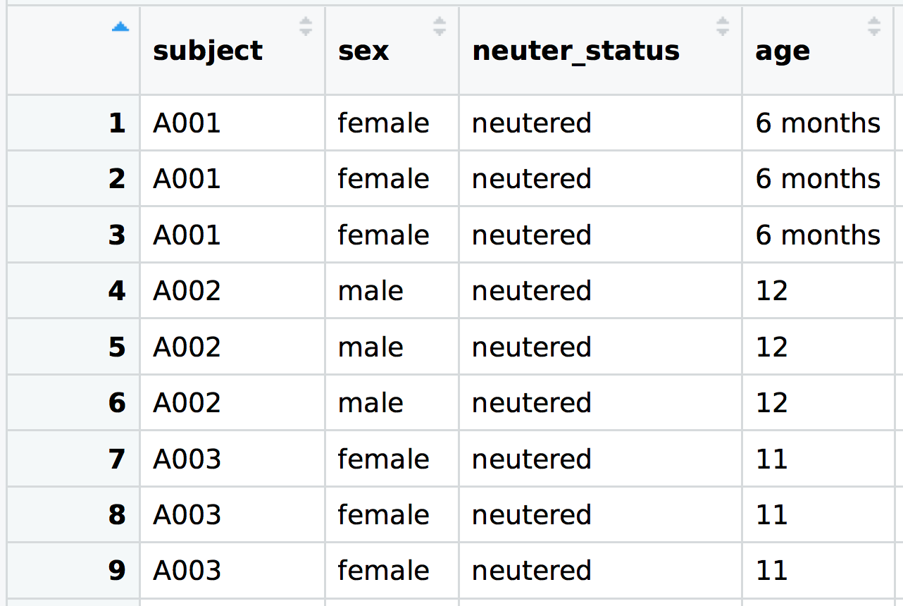
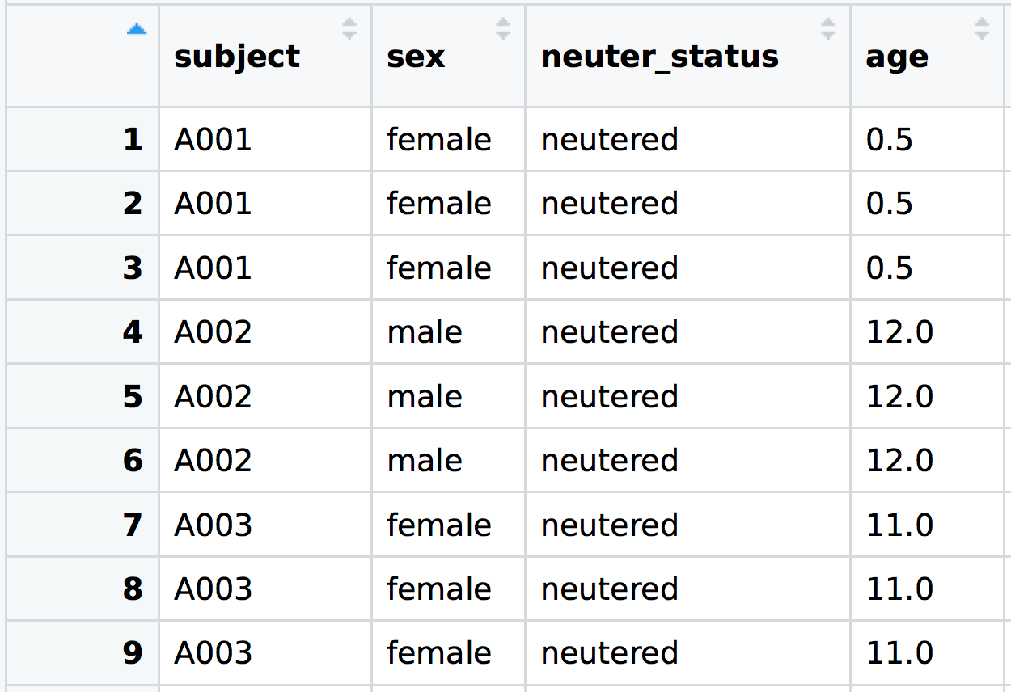
Convert ages in ‘months’ to ‘years’
dat <- dat %>%
mutate(age = case_when(
str_detect(age, "month") ~ parse_number(age) / 12,
TRUE ~ parse_number(age)))

Slide 23

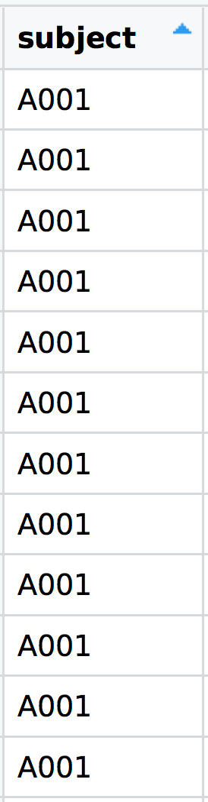
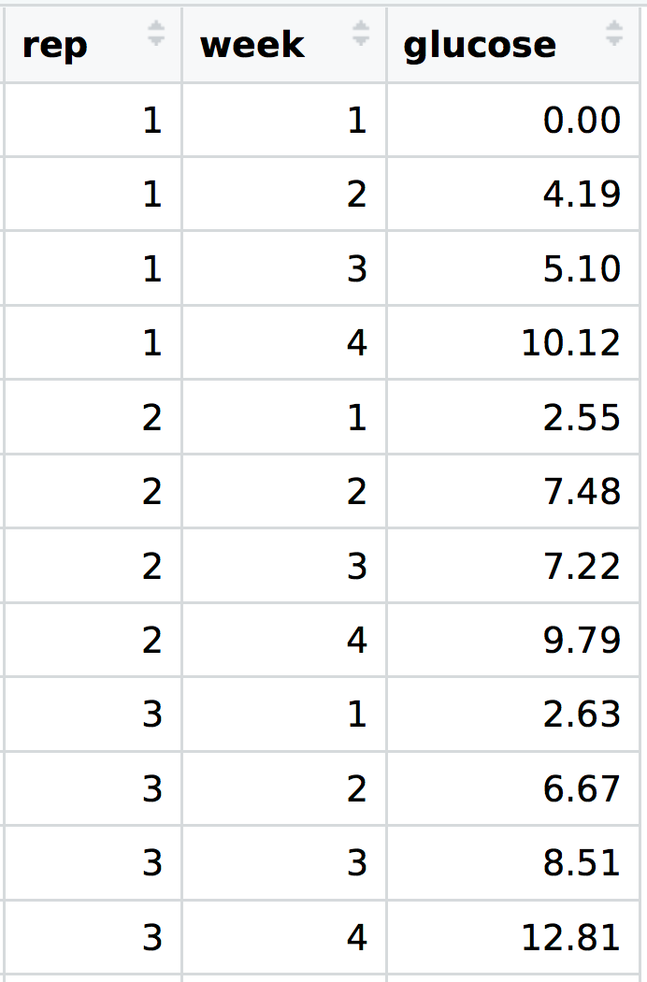
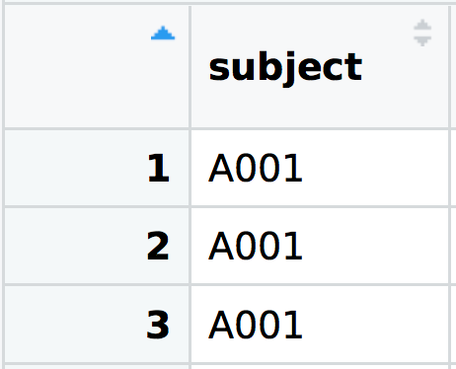
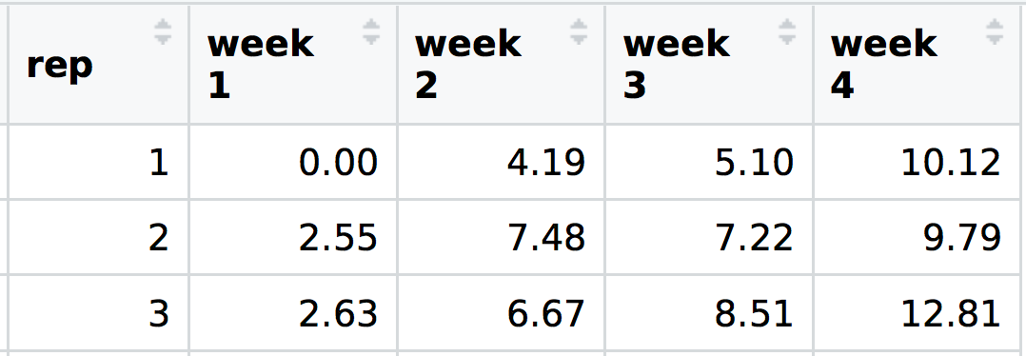
Gather the 4 results columns
dat <- dat %>%
gather("week", "glucose", `week 1`:`week 4`) %>%
mutate(week = parse_number(week))

Slide 24
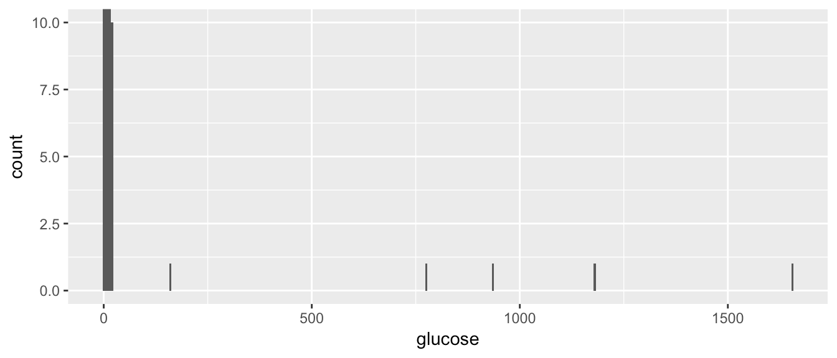
Explore the biochem results
ggplot(dat, aes(x = glucose)) +
geom_histogram(binwidth = 5) +
coord_cartesian(ylim = c(0, 10))
subject | week | rep | glucose
A006 | 1 | 2 | 162
A012 | 2 | 2 | 776
A012 | 3 | 1 | 1178
A003 | 4 | 2 | 935
A004 | 4 | 1 | 1654
dat %>%
filter(glucose > 50) %>%
select(subject, week, rep, glucose)

Slide 25
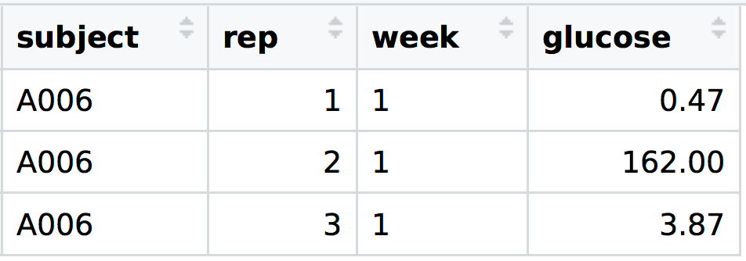
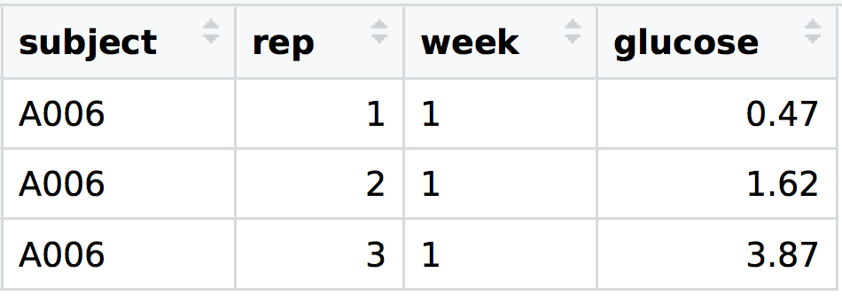
Correct age data typos
dat <- dat %>%
mutate(glucose = case_when(subject == "A006" &
week == 1 &
rep == 2 ~ 1.62,
subject == "A012" &
week == 2 &
rep == 2 ~ 7.76,
subject == "A012" &
week == 3 &
rep == 1 ~ 11.78,
subject == "A003" &
week == 4 &
rep == 2 ~ 9.35,
subject == "A004" &
week == 4 &
rep == 1 ~ 16.54,
TRUE ~ glucose))
etc…

Slide 26
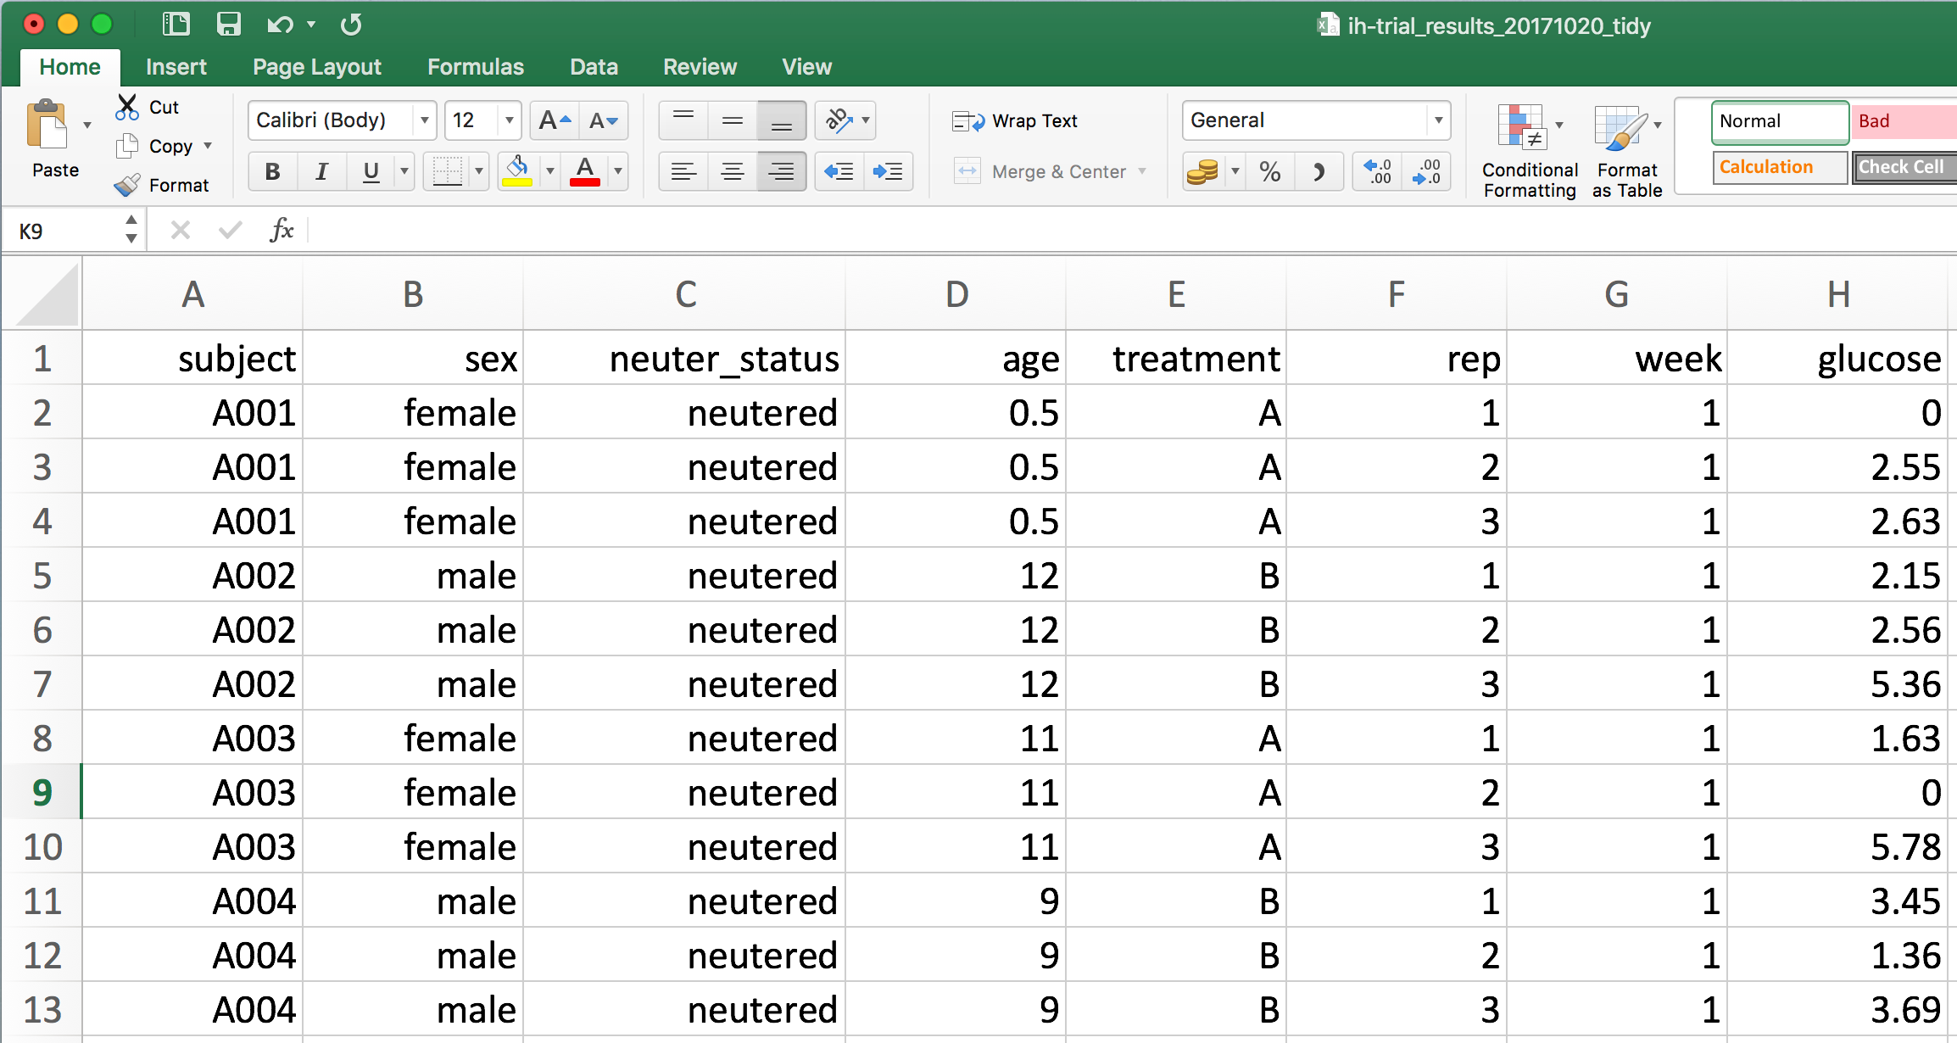
Save tidied data
write_csv(dat, "../data/ih-trial_results_20171020_tidy.csv")

Slide 27

Visualise
Import
Tidy
Transform
Communicate
Model

Slide 28

Visualise
Import
Tidy
Transform
Communicate
Model

Slide 29


Summarise data
dat %>%
select(subject, treatment, age) %>%
distinct() %>%
group_by(treatment) %>%
summarise(n = sum(!is.na(age)),
mean = mean(age),
median = median(age),
sd = sd(age),
min = min(age),
max = max(age)) %>%
ungroup()
treatment | n | mean | median | sd | min | max
A | 72 | 5.08 | 4.5 | 3.42 | 0.5 | 11
B | 72 | 8.00 | 8.0 | 2.60 | 5.0 | 12

Slide 30
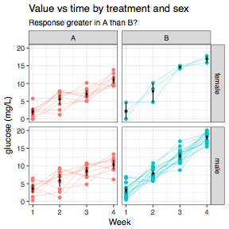
Visualise data
ggplot(dat) +
aes(week, glucose,
group = paste(subject, rep),
colour = treatment) +
geom_point() +
geom_line(alpha = 0.25) +
stat_summary(fun.data = "mean_cl_boot",
geom = "pointrange",
size = 0.5,
fatten = 0.2,
colour = "black",
group = 1) +
facet_grid(sex ~ treatment) +
guides(colour = FALSE) +
theme_bw() +
labs(title = "Value vs time by treatment and sex",
subtitle = "Response greater in A than B?",
x = "Week",
y = "glucose (mg/L)")

Slide 31
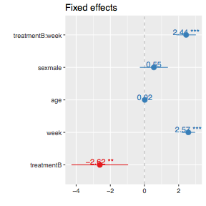
Do some ‘stats’
mod <- lmer(glucose ~ treatment * week + age + sex + (1 | subject), data = dat)
print(summary(mod)$coef, digits = 2)
sjPlot::sjp.lmer(mod, type = "fe")
Fixed effects:
Estimate Std. Error t value
(Intercept) -0.014 0.693 -0.02
treatmentB -2.617 0.846 -3.09
week 2.566 0.205 12.53
age 0.016 0.061 0.26
sexmale 0.549 0.419 1.31
treatmentB:week 2.439 0.290 8.42

Slide 32

Visualise
Import
Tidy
Transform
Communicate
Model

Slide 33
RMarkdown

Slide 34
Why reproducible research?
To demonstrate correctness / audit
To allow others to follow methods
To remember what happened…
Students graduate
Future you!

Slide 35
What next?
Half day workshop (the saga continues)
R for Datascience
Datacamp
Coursera
Data-Methods-Club…

Slide 36
Data-methods-club
How to get help (with R and other stuff)
Half day workshop on R
DMC Mailing list - just ask
Website - resources

